Slide 1
Basics Of Internet Technology
Lopamudra Dey

Slide 2
What is IT?
Internet refers to network of networks.
In this network each computer is recognized by a globally unique address known as IP address.
A special computer DNS (Domain Name Server) is used to give name to the IP Address so that user can locate a computer by a name.

Slide 3
Web Technology
Web technology refers to the means by which computers communicate with each other using markup languages and multimedia packages. It gives us a way to interact with hosted information, like websites.

Slide 4
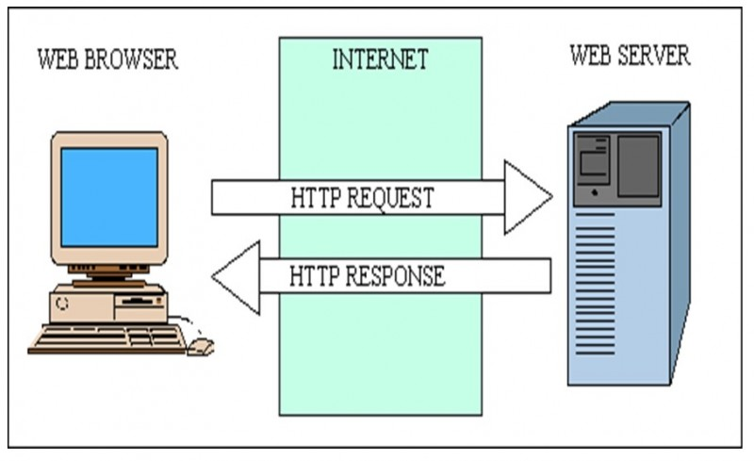
Web Server & Web Browser

Slide 5
Web Server:
Web server is a computer system, which provides the web pages via HTTP (Hypertext Transfer Protocol). IP address and a domain name is essential for every web server. Whenever, you insert a URL or web address into your web browser, this sends request to the web address where domain name of your URL is already saved. Then this server collects the all information of your web page and sends to browser, which you see in form of web page on your browser. Making a web server is not a difficult job. You can convert your computer into a web server with the help of any server software and connecting the computer to the internet.

Slide 6
Web Browser
Web browser is a client, program, software or tool through which we sent HTTP request to web server. The main purpose of web browser is to locate the content on the World Wide Web and display in the shape of web page, image, audio or video form. You can call it a client server because it contacts the web server for desired information. If the requested data is available in the web server data then it will send back the requested information again via web browser. Microsoft Internet Explorer, Mozilla Firefox, Safari, Opera and Google Chrome are examples of web browser and they are more advanced than earlier web browser because they are capable to understand the HTML, JavaScript, AJAX, etc.

Slide 7
Difference:
Web server is essential to store all information and data of websites. While web browser are used to access and locate these information and data.
Web browser is used to search something on the internet via websites. While web server is used to make the links between websites and web browser.
Web browser is a software or application which is used for collection and presentation of data in shape of websites while web server is a program server on computer or in cloud on internet that gives the data.
The communication is started by the web browser that requests for the specific page using the HTTP and then the web server respond against that request by either providing the requested content or giving the error message.

Slide 8
Web Page
web page is a document available on world wide web. Web Pages are stored on web server and can be viewed using a web browser.
A web page can contain huge information including text, graphics, audio, video and hyper links. These hyper links are the link to other web pages.
Collection of linked web pages on a web server is known as website. There is unique Uniform Resource Locator (URL) is associated with each web page.

Slide 9
Static Web page
Static web pages are also known as flat or stationary web page. They are loaded on the client’s browser as exactly they are stored on the web server. Such web pages contain only static information. User can only read the information but can’t do any modification or interact with the information.
Static web pages are created using only HTML. Static web pages are only used when the information is no more required to be modified.

Slide 10
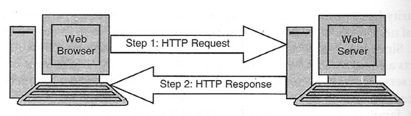

Slide 11
Dynamic Web page
Dynamic web page shows different information at different point of time. It is possible to change a portion of a web page without loading the entire web page. It has been made possible using Ajax technology.
SERVER-SIDE DYNAMIC WEB PAGE
It is created by using server-side scripting. There are server-side scripting parameters that determine how to assemble a new web page which also include setting up of more client-side processing.
CLIENT-SIDE DYNAMIC WEB PAGE
It is processed using client side scripting such as JavaScript. And then passed in to Document Object Model (DOM).

Slide 12
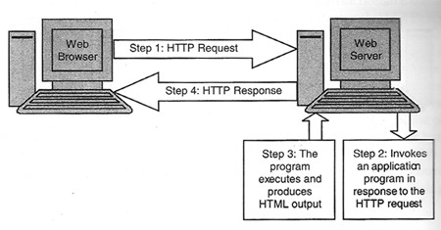

Slide 13
Active web pages
A web page is active , if it executes a program on the client i.e. web browser.
When client sends a HTTP request for an active web page, the web server sends back an HTTP response that contains an HTML page as usual. In addition , the HTML page also contains a small program that executes on the client computer inside the web browser.
Example: Java Applet, ActiveX control.
An applet is a client-side program written in the java programming language that can be executed by a web browser.

Slide 14
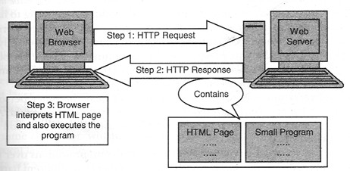

Slide 15
Static vs Dynamic
There are basically two main types of website - static and dynamic. A static site is one that is usually written in plain HTML and what is in the code of the page is what is displayed to the user.
A dynamic site is one that is written using a server-side scripting language such as PHP, ASP, JSP, or Coldfusion. In such a site the content is called in by the scripting language from other files or from a database depending on actions taken by the user.

Slide 16
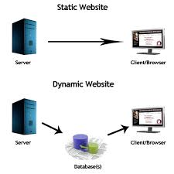

Slide 17
Web page and Web sites
The web page usually means what is visible, but the term may also refer to a computer file, usually written in HTML or a comparable markup language.
Web site: It is a collection of web pages like a brochure.
Home page

Slide 18
What is HTTP?
The Hypertext Transfer Protocol (HTTP) is designed to enable communications between clients and servers.
HTTP works as a request-response protocol between a client and server.
A web browser may be the client, and an application on a computer that hosts a web site may be the server.
Example: A client (browser) submits an HTTP request to the server; then the server returns a response to the client. The response contains status information about the request and may also contain the requested content.

Slide 19
Two HTTP Request Methods: GET and POST
Two commonly used methods for a request-response between a client and server are: GET and POST.
GET - Requests data from a specified resource
POST - Submits data to be processed to a specified resource
HEAD-Same as GET but returns only HTTP headers and no document body
PUT-Uploads a representation of the specified URI
DELETE-Deletes the specified resource
OPTIONS-Returns the HTTP methods that the server supports
CONNECT-Converts the request connection to a transparent TCP/IP tunnel

Slide 20
GET vs POST
Example of a GET request
www.someemailprovider.com/?login=joe@email.com&password=xxyz
A POST request, unlike a GET request, passes the form parameters in the body of the HTTP request, not in the URL. This happens behind the scenes, in what can be thought of as an HTTP ‘dialogue’ between your web browser and a webserver.

Slide 21
Topic | Get | Post
BACK button/Reload | Harmless | Data will be re-submitted (the browser should alert the user that the data are about to be re-submitted)
Bookmarked | Can be bookmarked | Cannot be bookmarked
Encoding type | application/x-www-form-urlencoded | application/x-www-form-urlencoded or multipart/form-data. Use multipart encoding for binary data
History | Parameters remain in browser history | Parameters are not saved in browser history
Restrictions on data length | Yes, when sending data, the GET method adds the data to the URL; and the length of a URL is limited (maximum URL length is 2048 characters) | No restrictions

Slide 22
Restrictions on data type | Only ASCII characters allowed | No restrictions. Binary data is also allowed
Security | GET is less secure compared to POST because data sent is part of the URL Never use GET when sending passwords or other sensitive information! | POST is a little safer than GET because the parameters are not stored in browser history or in web server logs
Visibility | Data is visible to everyone in the URL | Data is not displayed in the URL
BACK button/Reload | Harmless | Data will be re-submitted (the browser should alert the user that the data are about to be re-submitted)
Bookmarked | Can be bookmarked | Cannot be bookmarked

Slide 23
Thank You

